Slide 1
Investment destination plovdiv

Slide 2
Key facts
European capital of culture 2019;
History of Plovdiv dates back 6000 years;
#1 Industrial center of Bulgaria;
Stable demographics– over 0.5 million people;
4.5 billion euro GDP;
In the top 10 of Financial Times ranking for the destinations with most progressive development in the world;
Multinational manufacturers.

Slide 3
“The oldest living city in Europe” The Telegraph

Slide 4
Location in EU

Slide 5
Logistic advantages
Highway connection with Central and Western Europe;
Well-developed railway network, which offers a connection to the nearest port;
Intersection of Pan-European Transport Corridors (IV, VIII and X);
Airport, serving charter and cargo aircrafts (forthcoming concession);
Available Duty Free Zone.

Slide 6
To do business in Bulgaria
Index „protecting minority investors“ – 25th place (out of 190 countries, World Bank);
Index International Trade– 21st place (out of 190 countries, World Bank);
Index Government Debt– 2nd lowest in the EU (Eurostat);
+3.0% GDP growth– (2019);
20.4% government debt to GDP– 2nd lowest in the EU (Ministry of Finance, 2019)
10% corporate tax and personal income tax.

Slide 7
Population
The population of Plovdiv is over 535 000 people, 30 minutes from the city center;
Over 772 000 people live not more than 45 minutes from the region’s leading industrial zones;
7 500 new residents of the city;
2 500 international students;
1 800 annual population growth.
Source: NSI

Slide 8
Education
37
secondary schools
29 vocational high schools
34 200 students
2 500
International students
9 universities
7
12 284
students in vocational high schools
language high schools
11 354
students in secondary and language schools
77
vocational training centers

Slide 9
Workforce
17 900 growth of the workforce since 2010– the highest in all regions of Bulgaria;
70.3% employment rate (15-64 years.) – EU average: 68.5%.
Source: Trakia Tech, based on NSI data (data for the region, 2018)

Slide 10
Local economy
Production and business services make up 2/3 of the local economy;
Labor force volume– 323 thousand. (3.4mil. for Bulgaria);
Production– €8.8 billion (€92.5 billion for Bulgaria);
€4.5 billion GDP;
€6 700 GDP per capita;
€319 mil. FDI cumulative growth for the last 3 years;

Slide 11
Source: Trakia Tech, based on NSI data (date of the region, 2018)

Slide 12
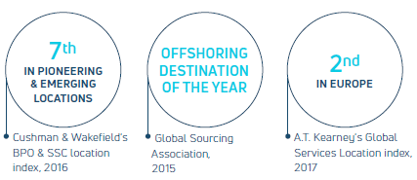
IT and Outsourcing of business services
Bulgaria is one of the most attractive outsourcing destination of the world;
Among the top 6 of developing cities– Annual CEE Shared Services Awards, 2018;
Bulgaria is in the top 4 of the countries in the world, where developers demonstrate the greatest diversity in technology knowledge and interests.
Source: A.T. Kearney, 2017

Slide 13
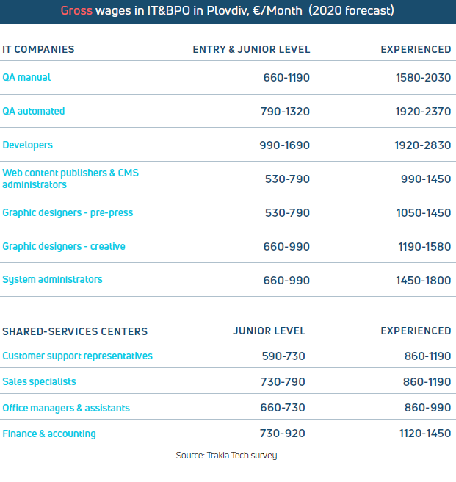
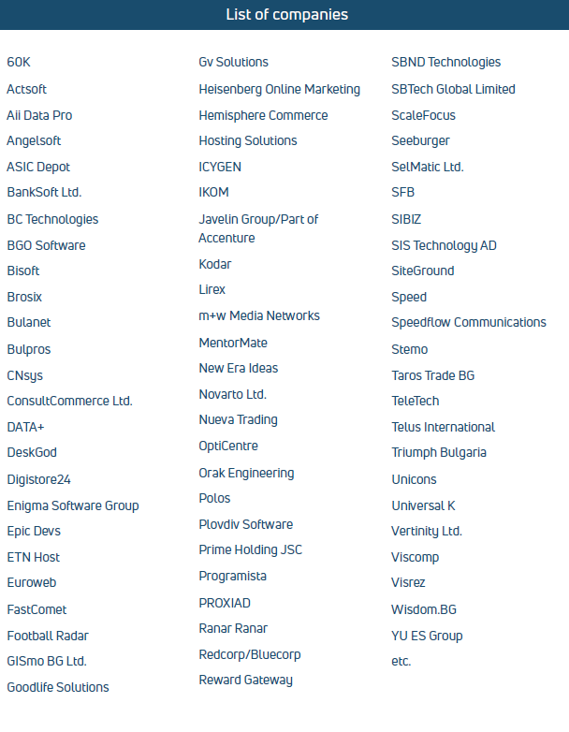
IT&BPO

Slide 14
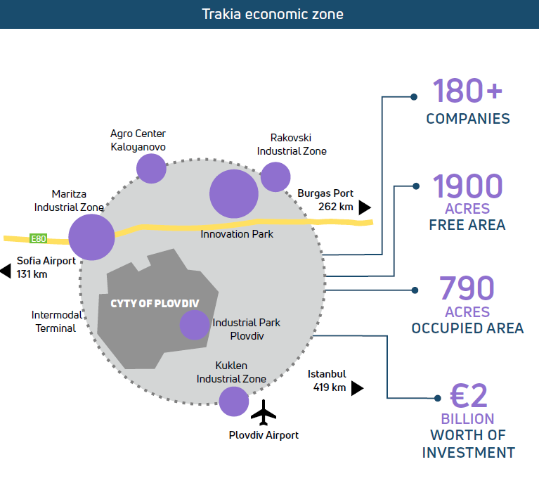

Slide 15
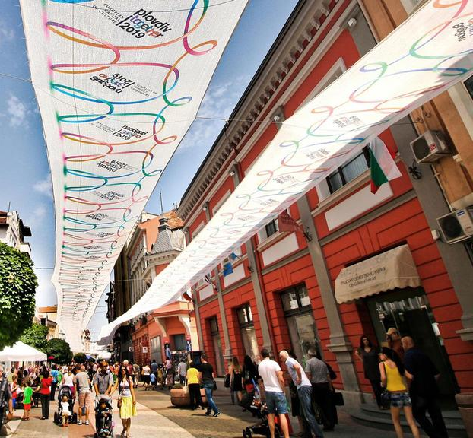
Real estate market
25-40 €/m² price for property for industrial use;
3-5 €/m² rent per month for industrial use;
9-12 €/m² monthly rent for Office Class А;
4-6 €/m² monthly rent for Office Class B.

Slide 16
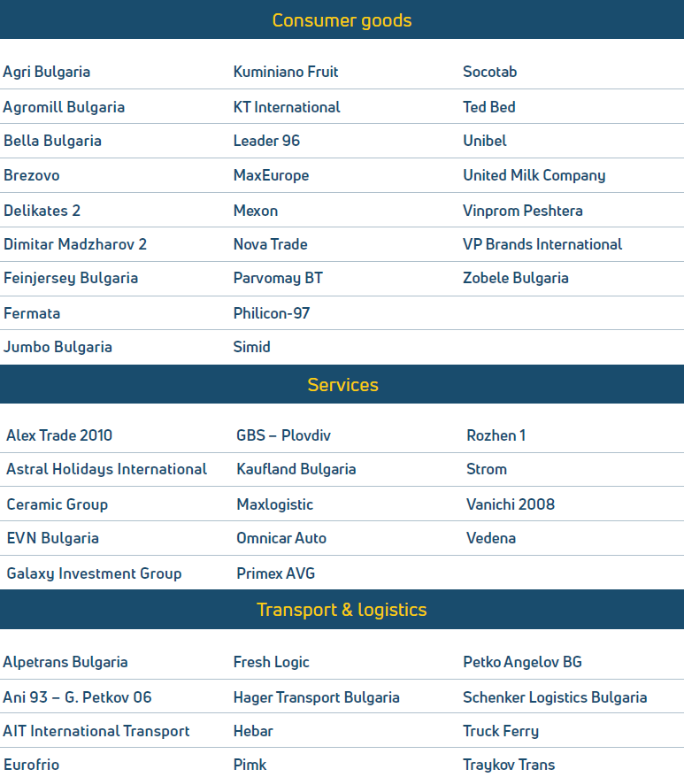
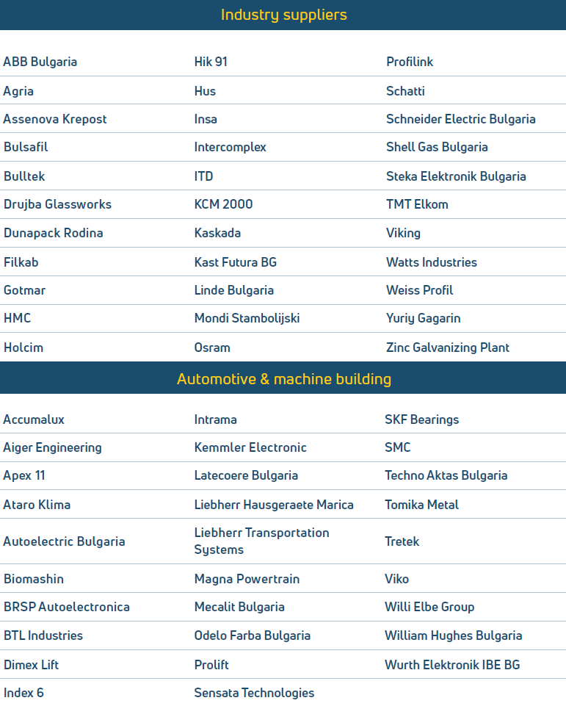
List of major investors in Plovdiv

Slide 17
“Business development and international cooperation” department
www.plovdiv.bg
www.invest.plovdiv.bg
info@plovdiv.bg
Deals with:
all administrative procedures;
building permits;
local utilities;
National institutions;
Establishing of public-private partnerships.
4000 Plovdiv, Sq. „Stefan Stambolov“ 1.
Phone.: +359 32 656 727, fax: +359 32 656 703

